Slide 1
Efficient Algorithms
From the lens of Competitive Programming
Yash Patel University of Bonn, Bonn, Germany

Slide 2
Outline
Max Flow Algorithms
Ford Fulkerson Algorithm
Edmond Karp Algorithm
Multi-source Multi-sink Max Flow Problem
1984
Application of Kadane’s 1D algorithm
Looking for Oil

Slide 3
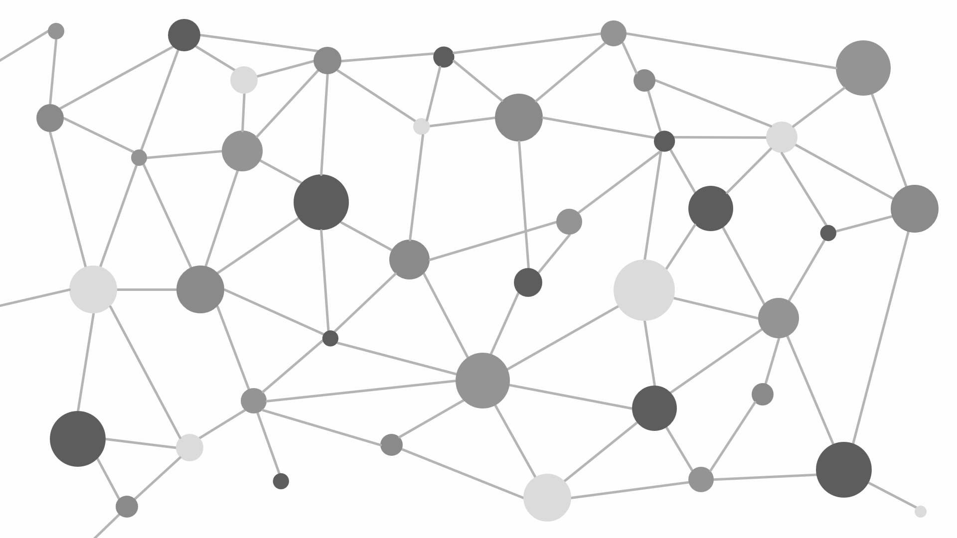
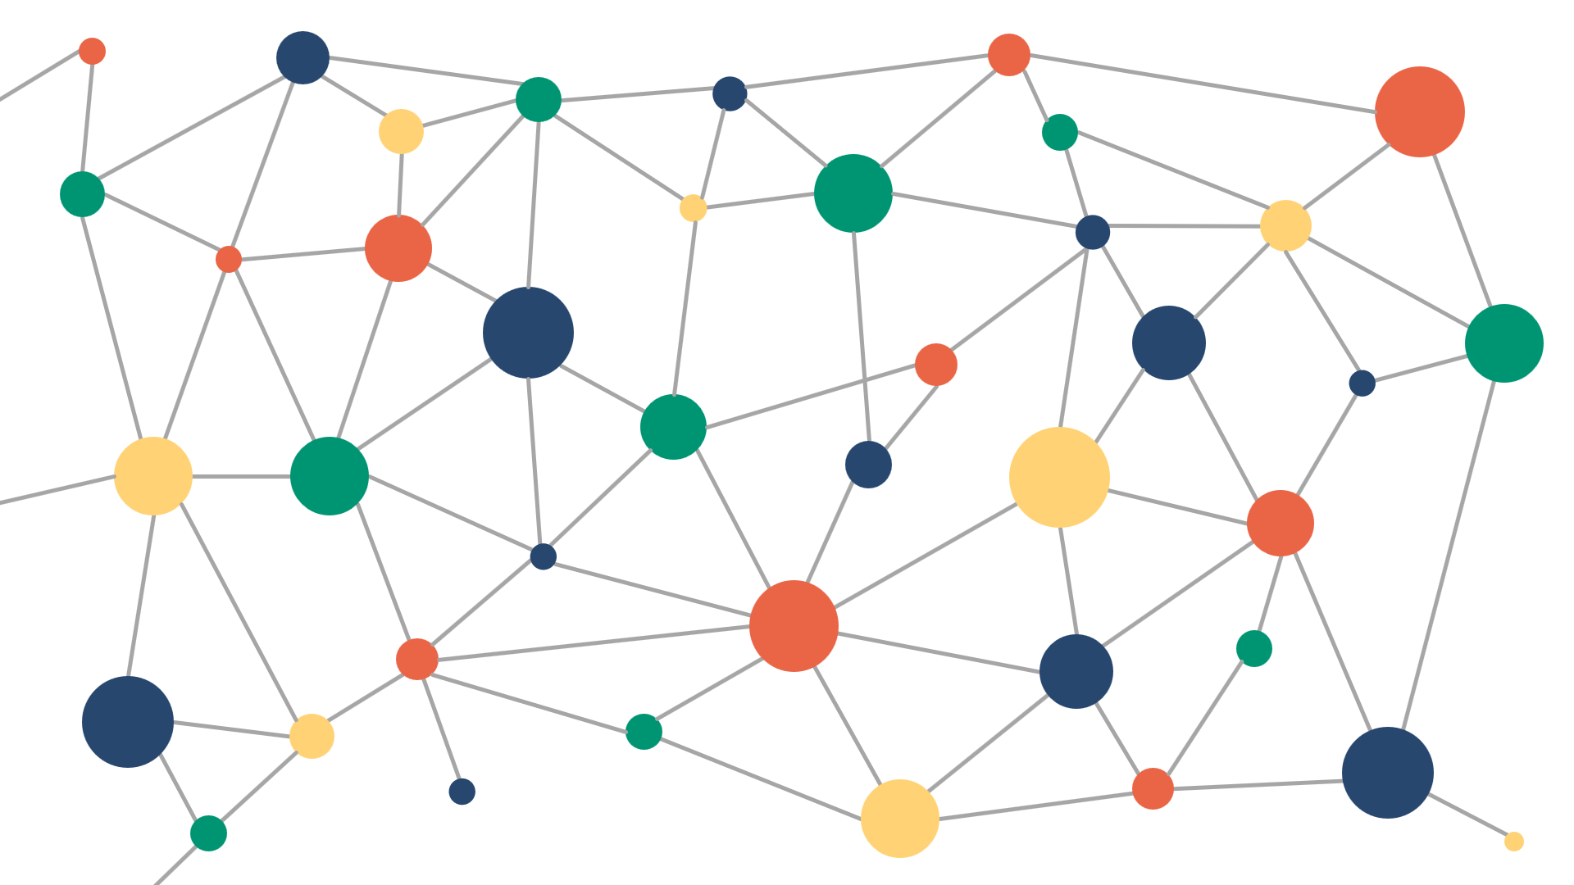
Max Flow Network
Capacitated directed graph :
Two distinguished nodes s (source) and t (sink).
u(e) defines the capacity of an arc e.

Slide 4
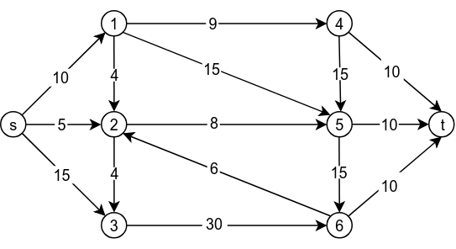
Max Flow Network: Example

Slide 5
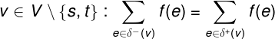
Max Flow Network: Flows
An s-t flow is a real valued function that satisfies:
For all (capacity)
For all (conservation)

Slide 6
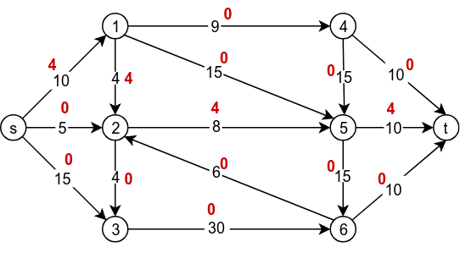
Max Flow Network: Example
An s-t flow is a real valued function that satisfies:
For all (capacity)
For all (conservation)
Max flow amounts to compute s-t flow that
maximizes the net flow
out of the source.
Value = 4

Slide 7
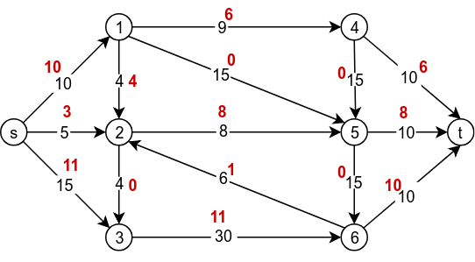
Max Flow Network: Example
An s-t flow is a real valued function that satisfies:
For all (capacity)
For all (conservation)
Max flow amounts to compute s-t flow that
maximizes the net flow
out of the source.
Value = 24

Slide 8
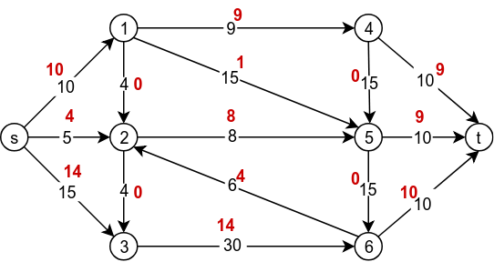
Max Flow Network: Example
An s-t flow is a real valued function that satisfies:
For all (capacity)
For all (conservation)
Max flow amounts to compute s-t flow that
maximizes the net flow
out of the source.
Value = 28

Slide 9
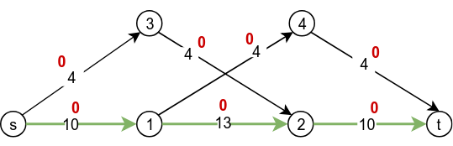
A Quest towards an algorithm
Find an s-t path where each arc has and augment flow along the path.
Value = 0

Slide 10
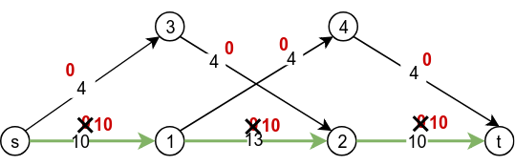
A Quest towards an algorithm
Find an s-t path where each arc has and augment flow along the path.
Repeat until an s-t path exists.
Value = 10

Slide 11
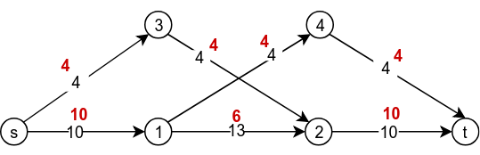

A Quest towards an algorithm
Find an s-t path where each arc has and augment flow along the path.
Repeat until an s-t path exists.
Value = 14
Value = 10

Slide 12
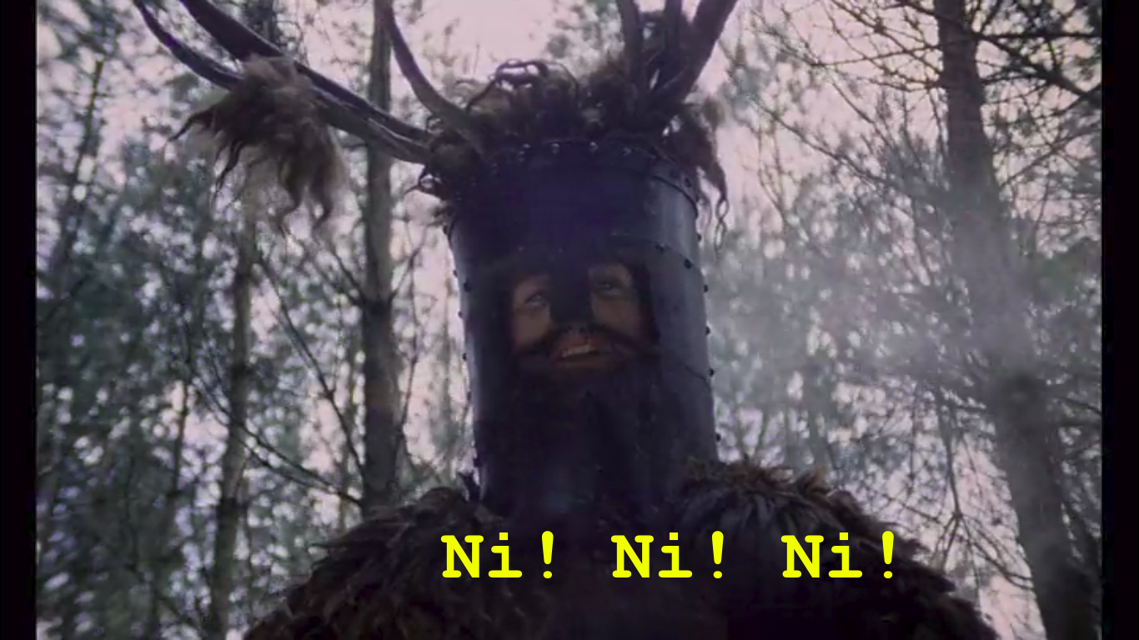

A Quest towards an algorithm
Find an s-t path where each arc has and augment flow along the path.
Repeat until an s-t path exists.
Value = 14
Value = 10

Slide 13
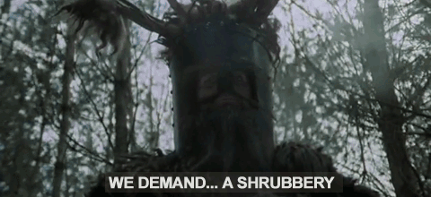
A Quest towards an algorithm
Find an s-t path where each arc has and augment flow along the path.
Repeat until an s-t path exists.
Value = 14
Value = 10

Slide 14
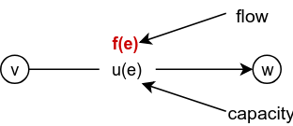
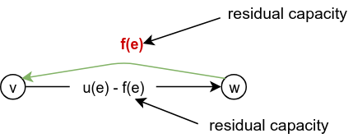
Shrubbery: Residual Arcs
Original Graph
Flow
Arc
Residual Graph
Residual arcs and
Send flow in reserve direction

Slide 15
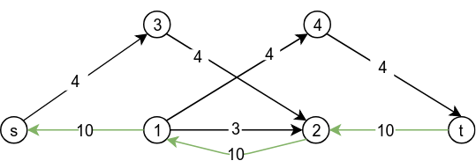
Shrubbery: Residual Graph
Residual Graph

Slide 16
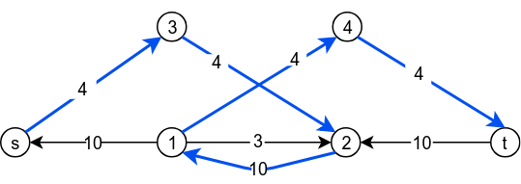
Shrubbery: Augmenting Path
Augmenting Path = Path in Residual Graph

Slide 17
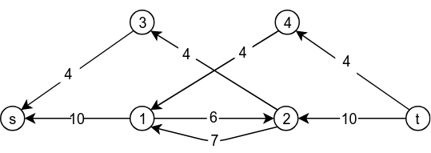
Shrubbery: Augmenting Path (3)
Augmenting Path = Path in Residual Graph
Max Flow ⇔ no augmenting path exists?
Value = 14
Notes:
Augmenting paths only contain unsaturated edges !!!!
Here we can see that the edges coming out from s are saturated and so are the others entailing that the value of max flow is 14.

Slide 18
You shall pass: Ford Fulkerson
Ford-Fulkerson (G, u, s, t):
Initialize flow f(v,w) to zero
while there exists an augmenting path P do:
augment flow f along P
return f
Remark (Ford-Fulkerson Theorem): No augmenting path ⇔ the current flow is maximum.

Slide 19
You shall pass: Ford Fulkerson
Ford-Fulkerson (G, u, s, t):
for each edge do:
f(v,w) ← 0
f(w,v) ← 0
while there exists an augmenting path P from s to t in do:
for each edge (v,w) in P do:
f(v,w) ← f(v,w) + u_{f}(P)
f(w,v) ← f(w,v) - u_{f}(P)
Notes:
u_f(P) is the maximum amount of flow we can push through augmenting path P in G_f

Slide 20
You shall pass: Ford Fulkerson
Ford-Fulkerson (G, u, s, t):
for each edge do:
f(v,w) ← 0
f(w,v) ← 0
while there exists an augmenting path P from s to t in do:
for each edge (v,w) in P do:
f(v,w) ← f(v,w) + u_{f}(P)
f(w,v) ← f(w,v) - u_{f}(P)
Comment: Notice that it is not certain that E = E_{f} as sending flow on (v,w) might close (v,w), and may open a new edge (w,v) in the residual graph.

Slide 21
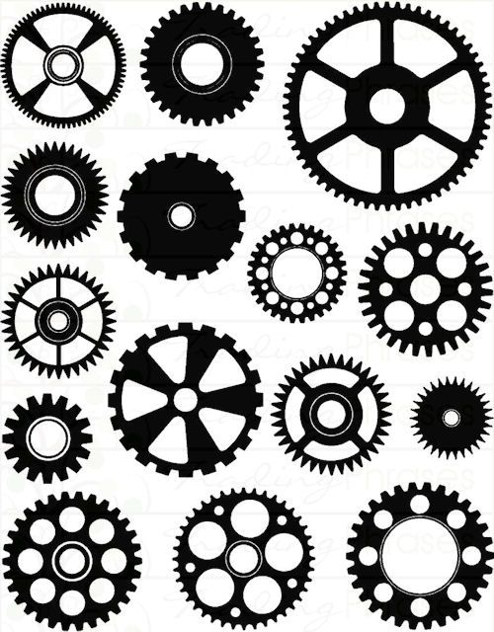
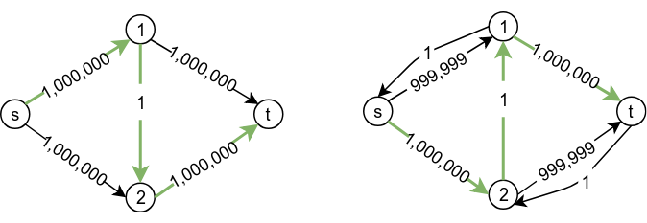
Ford Fulkerson: Time Analysis
How many such iterations?
2,000,000
Pseudo-polynomial run time. The running time of the algorithm is O(|f*|E) when capacities are integers.
Notes:
Clearly max flow is 2X, but ford fulkerson algorithm might take the alternate of s12t and s21t, hence the running time is \theta(X) = \Omega(f*). Caveat : Does not specify which augmenting path to use if there are multiple of them
pseudo -polynomial time : running time is polynomial in numeric value of the input (largest integer present)

Slide 22
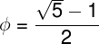
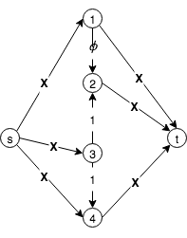
Ford Fulkerson: No convergence
A bad example for Ford Fulkerson algorithm. Here
That is, it with irrational capacities, the algorithm runs for exponential time, finding smaller augmenting paths in each iteration, and this doesn’t converge to a single value.
Notes:
Why irrational capacities: 1) integer restriction is artificial 2) behavior of the algorithm with irrational inputs tells us something about its worst-case behavior in practice given floating-point capacities 3) carelessly implemented ford fulkerson can easily enter an infinite loop because of round of error

Slide 23
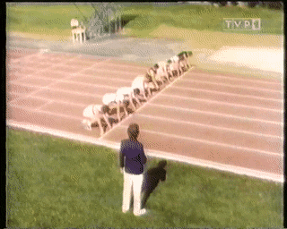
Ford Fulkerson: No convergence
A bad example for Ford Fulkerson algorithm. Here
That is, it with irrational capacities, the algorithm runs for exponential time, finding smaller augmenting paths in each iteration, and this doesn’t converge to a single value.

Slide 24
Choosing augmenting paths wisely can make the algorithm efficiently.
Which leads to...

Slide 25
A Polynomial Algorithm

Slide 26
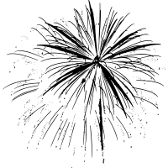
Edmonds Karp Algorithm
Notes:
Choose augmenting path with:
Max bottleneck capacity (fat pipe), Sufficiently large capacity (capacity scaling), Fewer number of arcs (shortest path)

Slide 27

Edmonds Karp Algorithm
Choosing augmenting paths as shortest path with available capacity.
This is done by giving edge weights of one to each edge and apply BFS.

Slide 28
Edmonds Karp: By example
The algorithm only needs two s-t paths s→1→t and s→2→t. That is, it does not get trapped into longer paths s→1→2→t or s→2→1→t.

Slide 29
Edmonds Karp: Time Analysis
After O(VE) iterations of BFS, all augmenting paths exhaust.
As BFS runs in O(V + E) time, the overall time complexity is O(V²E).

Slide 30
Multi-source Multi-sink Max Flow
Task: Given multiple sources (S = {s₁,...,s_{a}}) and multiple sinks (T = {t₁,...,t_{b}}), compute the maximum flow between sources and sinks

Slide 31
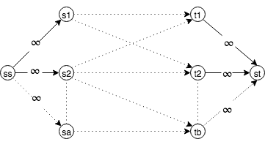
Multi-source Multi-sink Max Flow
After constructing such a graph for an instance, run Edmonds Karp algorithm as normal.

Slide 32
1984
Task: Given an undirected graph where , find stations V and tracks E such that
s and t are in different connected components of G(V-stations, E-tracks).
c(stations tracks) is minimal.

Slide 33
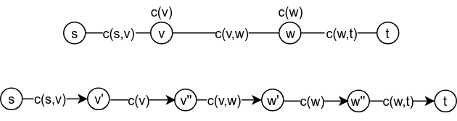
1984
Remark (Ford-Fulkerson Theorem): In any network, the value of maximum s-t flow is equal to the value minimum s-t cut.
Run Edmonds Karp on the newly transformed graph

Slide 34
Kadane’s 1D Algorithm
Task: Given a 1D array A[1..n], find the contiguous subarray of numbers with largest sum.
-2 | -3 | 4 | -1 | -2 | 1 | 5 | -3
Maximum sum contiguous subarray sum = 7

Slide 35

Kadane’s 1D Algorithm
Idea: Look for all positive contiguous subarrays (max_here) and simultaneously also keep track of maximum sum contiguous subarray (max_so_far) among all positive subarrays.
Each time a subarray with positive sum is found, it is compared with the maximum sum so far and the maximum so far is update accordingly.

Slide 36
Kadane’s 1D Algorithm
max_here = maximum subarray of A[0..i] of those ending precisely at i
max_so_far = maximum subarray of A[0..i]
max_here = 0, max_so_far = 0
for i = 1 to n do:
max_here = max(max_here + A[i], max_here)
max_so_far = max(max_here, max_so_far)

Slide 37
Looking for Oil
Task: Given an nxn quadratic land M, partition the land into rectangle parcels and find the rectangle parcel with maximum profit.
0 | -2 | -7 | 0
9 | 2 | -6 | 2
-4 | 1 | -4 | 1
-1 | 8 | 0 | -2
Max sum = 15

Slide 38
Looking for Oil: Brute-force
for i to n do: for j to n do:
for k = i to n do: for l = j to n do:
sub_mat = 0
for a = i to k do: for b = j to l do:
sub_mat += M[a][b]
max_sub_mat = max(max_sub_mat, sub_mat)
// start coordinate
// end coordinate
//sum of submatrix

Slide 39
Looking for Oil: Brute-force
for i to n do: for j to n do:
for k = i to n do: for l = j to n do:
sub_mat = 0
for a = i to k do: for b = j to l do:
sub_mat += M[a][b]
max_sub_mat = max(max_sub_mat, sub_mat)
// start coordinate
// end coordinate
//sum of submatrix
O(n⁶) running time!

Slide 40
Looking for Oil: O(n⁴) time
Idea: Kadane’s algorithm for 1D array can be extended to work in 2D as long as inclusion-exclusion principle is properly applied.
Transform the input matrix into an cumulative sum matrix, where M[i][j] represents the sum of all items within submatrix (0,0) to (i,j).

Slide 41
Looking for Oil: O(n⁴) Example
0 | -2 | -7 | 0
9 | 2 | -6 | 2
-4 | 1 | -4 | 1
-1 | 8 | 0 | -2
0 | -2 | -9 | -9
9 | 9 | -4 | 2
5 | 6 | -11 | -8
4 | 13 | -4 | -3
0 | -2 | -9 | -9
9 | 9 | -4 | 2
5 | 6 | -11 | -8
4 | 13 | -4 | -3
Max sum = 15
cumulative sum matrix
sum of submatrix (1,2)
to (3,3) = A[3,3] - A[0,3] - A[3,1] + A[0,1]

Slide 42
Looking for Oil: O(n⁴) time
for i to n do: for j to n do:
for k = i to n do: for l = j to n do:
sub_mat = M[k][l]
if i > 0 do: sub_mat -= M[i-1][l]
if j > 0 do: sub_mat -= M[k][j-1]
if i > 0 & j > 0 do: sub_mat += M[i-1][j-1]
max_sub_mat = max(max_sub_mat, sub_mat)
// start coordinate
// end coordinate
//sum of submatrix [k][l]
Notes:
calculate the cumulative sum for all columns. Assuming that the maximum subarray is between row r1 and r2 (inclusive) try all O(n 2 ) (r1,r2) pairs such that r1 < r2. Since, we have already computed the cumulative sum of all columns, the sum of elements in A[r1 . . .r2][c] for column c can be computed in O(1) time.
Intuitively, this means that each cumulative sum for a column is an element of a 1D array across all columns, that is 1D array with one row and n columns. Using the 1D counterpart (O(n)) as a subroutine inside each rows r1 and r2 combined gives an algorithm with running time O(n 3 )

Slide 43
Questions?

Slide 44

Thank You.

